Slide 1
Product Architecture
Teaching materials to accompany:
Product Design and Development
Chapter 10
Karl T. Ulrich and Steven D. Eppinger
5th Edition, Irwin McGraw-Hill, 2012.

Slide 2
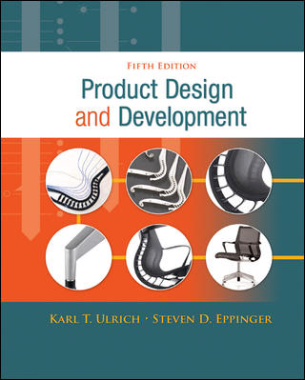
Product Design and Development
Karl T. Ulrich and Steven D. Eppinger
5th edition, Irwin McGraw-Hill, 2012.
Chapter Table of Contents:
Introduction
Development Processes and Organizations
Opportunity Identification
Product Planning
Identifying Customer Needs
Product Specifications
Concept Generation
Concept Selection
Concept Testing
Product Architecture
Industrial Design
Design for Environment
Design for Manufacturing
Prototyping
Robust Design
Patents and Intellectual Property
Product Development Economics
Managing Projects

Slide 3
Product Development Process
Planning
Concept
Development
System-Level
Design
Detail
Design
Testing and
Refinement
Production
Ramp-Up
Platform decision
Concept decision
Decomposition decision
Product architecture is determined early in the development process.

Slide 4

Product Architecture Example:
Hewlett-Packard DeskJet Printer

Slide 5
Outline
Definition
Modularity
Steps for creating the architecture
Related system level design issues

Slide 6
Definition
– Product Architecture
A scheme by which the functional elements of the product are arranged (or assigned) into physical building blocks (chunks) and by which the blocks interact.

Slide 7
Product Architecture: Definition
The arrangement of functional elements into physical chunks which become the building blocks for the product or family of products.
module
module
Product
module
module
module
module
module
module

Slide 8
Considerations at product architecturing
How will it affect the ability to offer product variety?
How will it affect the product cost?
How will it affect the design lead time?
How will it affect the development process management?

Slide 9
Modular vs. integrated architecture
Modular
  Chunks implement one or a few functional elements in their entirety (each functional element is implemented by exactly one physical chunks)
  The interactions between chunks are well defined and are generally fundamental to the primary functions of the products.
Integrated
  Functional elements of the product are implemented using more than one chunk
  A single chunk implements many functions.
  The interaction between chunks are ill defined and may be incidental to the primary functions of the products.

Slide 10
Factors affecting architecture modularity
Product changes
Product variety
Component standardization
Product performance
Manufacturability
Product development management

Slide 11
Factors affecting architecture modularity (product changes)
For modular architecture
Allows to minimize the physical changes required to achieve a functional change
Reasons for product changes
upgrades
add-ons
adaptation (adapt to different operation environments)
wear (e.g., razors, tires, bearings)
consumption (for example, toner cartridges, battery in cameras)
flexibility in use (for users to reconfigure to exhibit different capabilities)
re-use in creating subsequent products

Slide 12
Factors affecting architecture modularity (product variety)
The range of products (models) concurrently available in the market
Modular can vary without adding tremendous complexity to the manufacturing system.

Slide 13
Factors affecting architecture modularity
Component standardization
  Use the same components in multiple products
  Increase production volumes

Slide 14
Factors affecting architecture modularity
Product performance (for integrated design)
  Allow optimizing the performance for an individual integrated architecture.
  Allow function sharing
    Implementing multiple functions using a single physical element.
  Allow for redundancy to be eliminated through function sharing and geometric nesting
    Thus could lower the manufacturing cost

Slide 15
Factors affecting architecture modularity
Manufacturability
  DFM can be performed on the chunk-level but not across several chunks.
    For example, minimize the total number of part counters.
  Thus, it is more applicable to an integrated design.

Slide 16
Factors affecting architecture modularity
Product development management
  Better for modular architecture
    Each modular chunk is assigned to an individual or a small group
    Known and relatively limited functional interactions with other chunks.
  Not as easy for integrated architecture
    Detailed designs will require close coordination among different groups.

Slide 17
Architecture Design Process
create a schematic of the product
cluster the elements of the schematic
create a rough geometric layout
identify the fundamental and incidental interactions.

Slide 18
Creating a product schematic
Create a schematic diagram representing the (physical or functional) elements of the product, using blocks, arrows, and other notations.
  Flow of forces or energy
  Flow of material
  Flow of signal or data

Slide 19
Cluster the elements of the schematic
Factors for considering clustering
  Geometric integration and precision
  Function sharing
  Capability of vendors
  Similarity of design or production technology
  Localization of design (or part) change
  Accommodating variety
  Enabling standardization
  Portability of the interfaces

Slide 20
Creating a rough geometric layout
A geometric system layout in
  2D or 3D drawings,
  2D or 3D graphics, or
  Physical models.

Slide 21
Identify the fundamental and incidental interactions
Fundamental interactions
  Those which connect the building blocks, such as energy flows, material flows, and data flows.
Incidental interactions
  Those that arise because of geometric arrangements of the building blocks, such as thermal expansion or heat dissipation.

Slide 22
Differentiation Postponement (delayed differentiation)
The timing of differentiation in the supply chain
  Modular components vs. final assembly for each model in the inventory.
Two principles
  Differentiating elements must be concentrated in one or a few chunks
  The product and production process must be designed so that the differentiating chunks can be added to the product near the end of the supply chain.

Slide 23
Platform planning
Trade-off decision between
  Differentiation plan
    Difference in product attributes from customer’s viewpoint
  Commonality plan
    The components which the product versions commonly share. Therefore, their physicals are the same across the products in the platform.

Slide 24
Guidelines for managing platform trade-off
Platform planning decision should be informed by quantitative estimates of cost and revenue implications.
Iteration is beneficial.
The nature of trade-off between differentiation and commonality is not fixed.
  The product architecture dictates the nature of the trade-off.
  The team may consider alternative architectures to enhance both differentiation and commonality.

Slide 25
Related system-level design issues
A recursive process
  Defining secondary systems
  Establishing the architecture of the chunks
  Creating detailed interface specifications

Slide 26
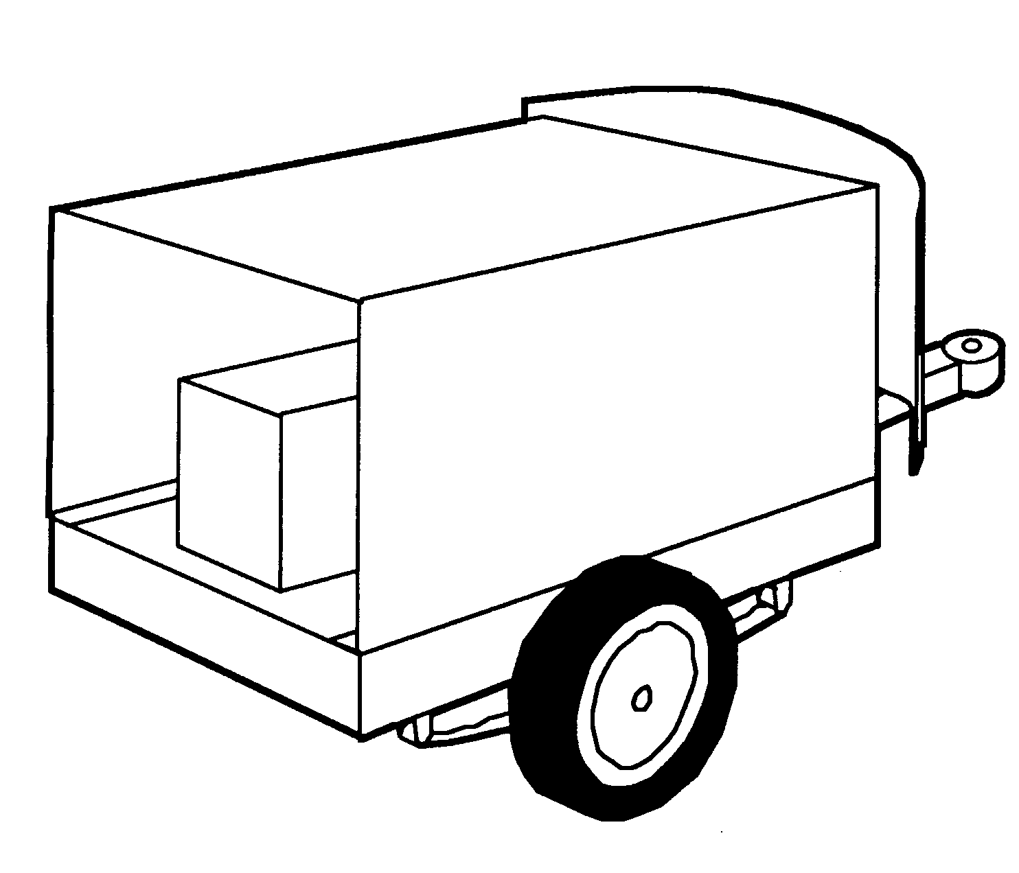
Trailer Example:
Modular Architecture
box
protect cargo
from weather
hitch
connect to
vehicle
fairing
minimize
air drag
bed
support
cargo loads
springs
suspend
trailer structure
wheels
transfer loads
to road

Slide 27
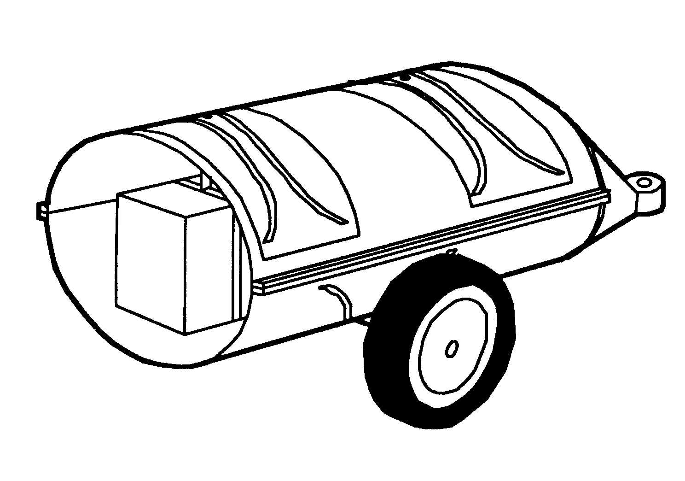
Trailer Example:
Integral Architecture
upper half
protect cargo
from weather
lower half
connect to
vehicle
nose piece
minimize
air drag
cargo hanging
straps
support
cargo loads
spring slot
covers
suspend
trailer structure
wheels
transfer loads
to road

Slide 28
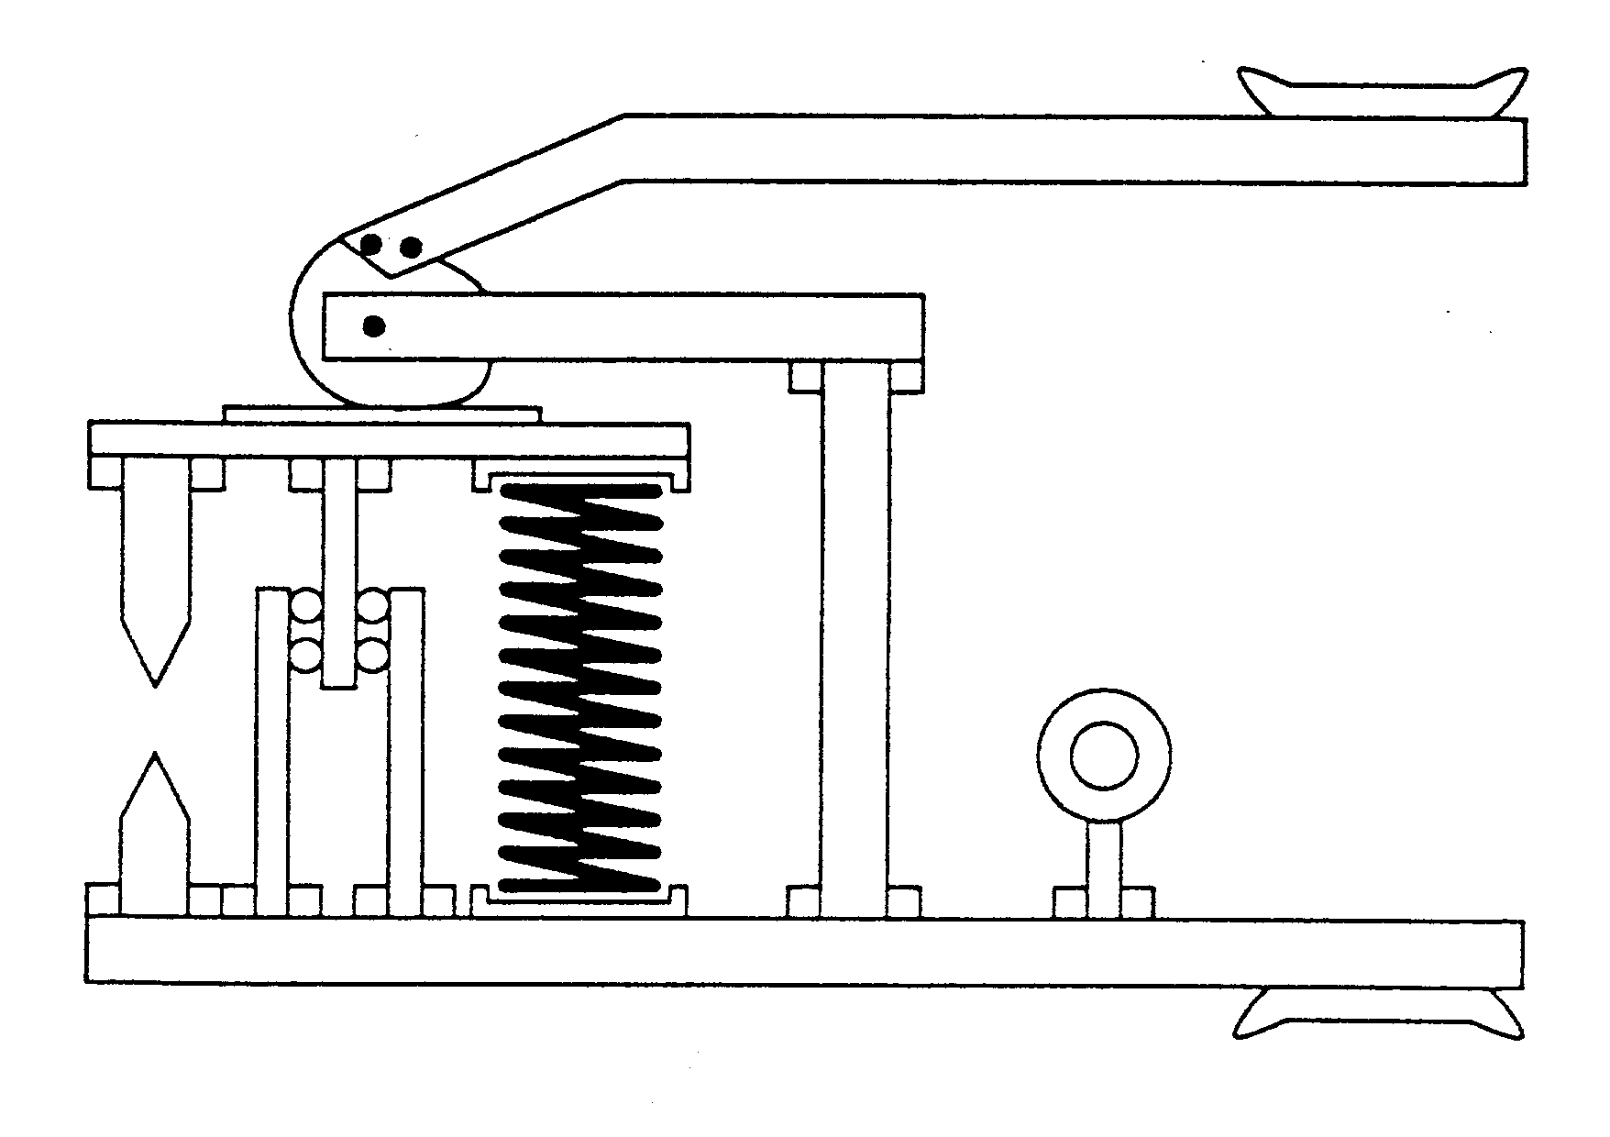
What is this?

Slide 29
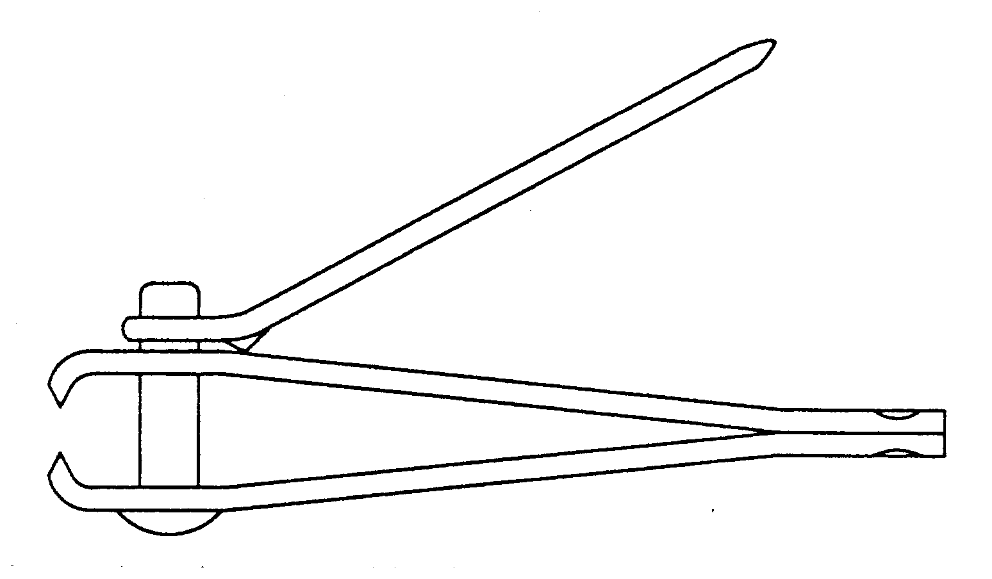
Nail Clippers?

Slide 30


Modular Product Architectures
Chunks implement one or a few functions entirely.
Interactions between chunks are well defined.
Modular architecture has advantages in simplicity and reusability for a product family or platform.
Swiss Army Knife
Sony Walkman

Slide 31
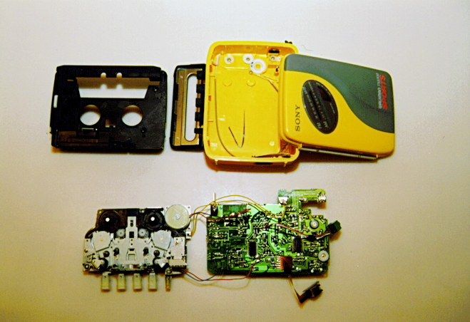
Platform Architecture of the Sony Walkman

Slide 32
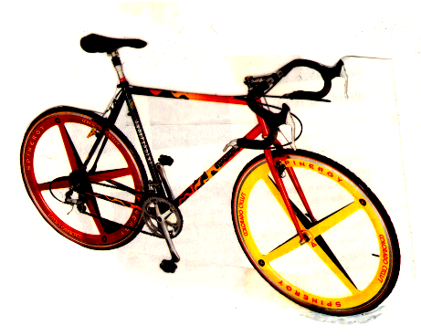
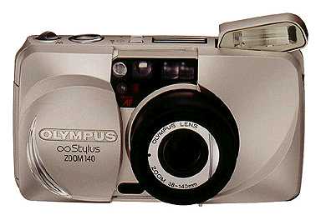
Integral Product Architectures
Functional elements are implemented by multiple chunks, or a chunk may implement many functions.
Interactions between chunks are poorly defined.
Integral architecture generally increases performance and reduces costs for any specific product model.
High-Performance Wheels
Compact Camera

Slide 33
Choosing the Product Architecture
Architecture decisions relate to product planning and concept development decisions:
Product Change (copier toner, camera lenses)
Product Variety (computers, automobiles)
Standardization (motors, bearings, fasteners)
Performance (racing bikes, fighter planes)
Manufacturing Cost (disk drives, razors)
Project Management (team capacity, skills)
System Engineering (decomposition, integration)

Slide 34
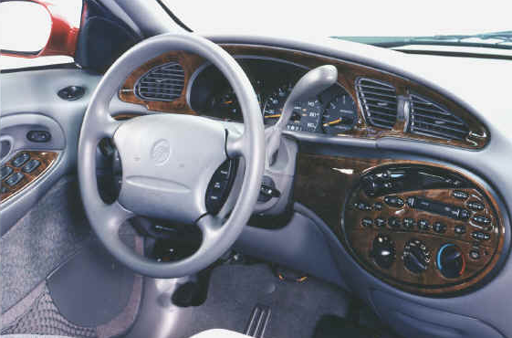
Ford Taurus
Integrated Control Panel

Slide 35

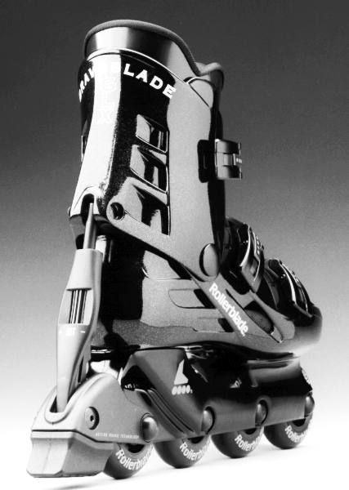


Modular or Integral Architecture?
Apple
iBook
Motorola StarTAC
Cellular Phone
Ford
Explorer
Rollerblade
In-Line Skates

Slide 36
The concepts of integral and modular apply at several levels:
system
sub-system
component

Slide 37
Product Architecture = Decomposition + Interactions
Interactions within chunks
Interactions across chunks

Slide 38
Establishing the Architecture
To establish a modular architecture, create a schematic of the product, and cluster the elements of the schematic to achieve the types of product variety desired.

Slide 39
Product Architecture Example:
Hewlett-Packard DeskJet Printer

Slide 40
DeskJet Printer Schematic
Enclose
Printer
Print
Cartridge
Provide
Structural
Support
Position
Cartridge
In X-Axis
Accept
User
Inputs
Display
Status
Store
Output
Position
Paper
In Y-Axis
Control
Printer
Store
Blank
Paper
“Pick”
Paper
Supply
DC
Power
Communicate
with
Host
Command
Printer
Functional
or Physical
Elements
Flow of forces or energy
Flow of material
Flow of signals or data
Connect
to
Host

Slide 41
Cluster Elements into Chunks
Enclosure
Enclose
Printer
Print
Cartridge
Provide
Structural
Support
User Interface Board
Position
Cartridge
In X-Axis
Accept
User
Inputs
Display
Status
Chassis
Store
Output
Position
Paper
In Y-Axis
Control
Printer
Power Cord
and “Brick”
Store
Blank
Paper
“Pick”
Paper
Supply
DC
Power
Paper Tray
Print
Mechanism
Communicate
with
Host
Command
Printer
Functional
or Physical
Elements
Chunks
Host Driver
Software
Connect
to
Host
Logic Board

Slide 42
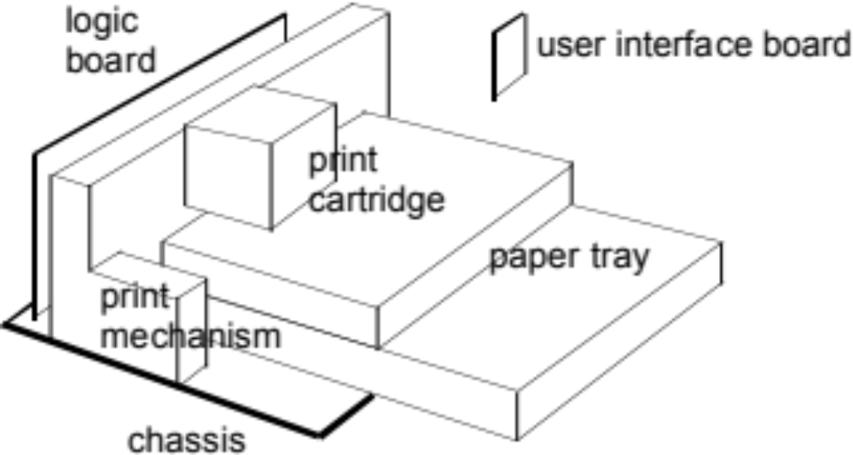
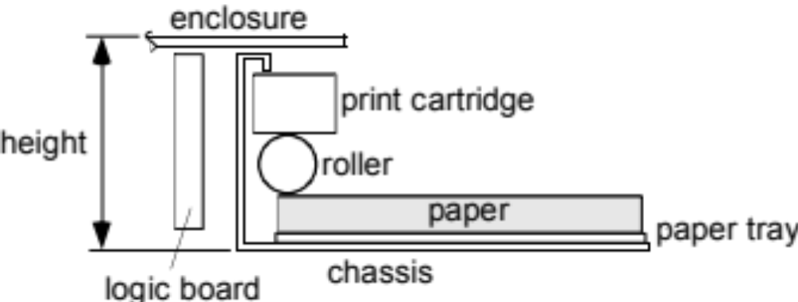
Geometric Layout

Slide 43
Incidental Interactions
Enclosure
User Interface
Board
Styling
Thermal Distortion
Paper Tray
Vibration
Print
Mechanism
Logic
Board
Host Driver
Software
Thermal Distortion
RF Interference
RF Shielding
Chassis
Power Cord
and “Brick”

Slide 44
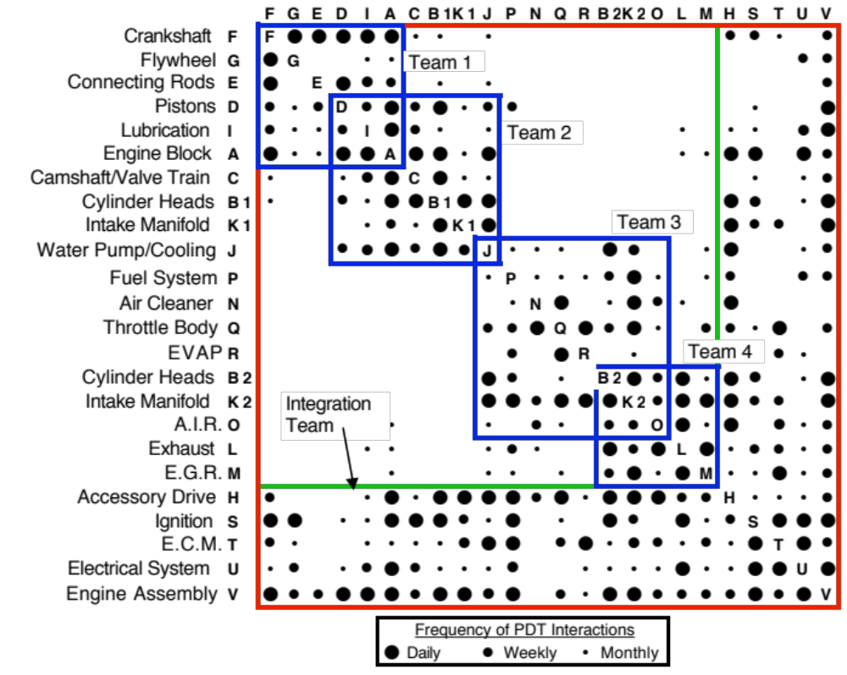
System Team Assignment
Based on Product Architecture
From “Innovation at the Speed of Information”, S. Eppinger, HBR, January 2001.

Slide 45
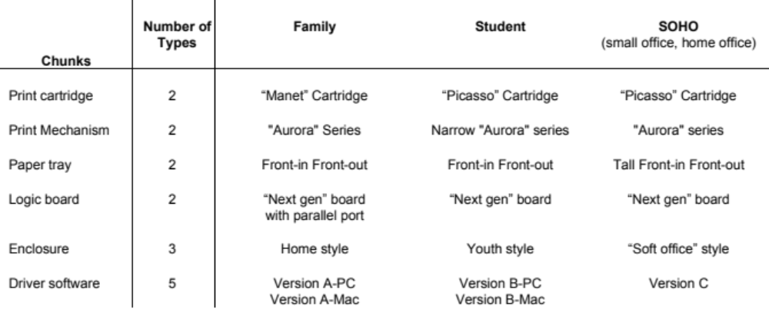
Planning a Modular Product Line:
Commonality Table
Differentiation versus Commonality
Trade off product variety and production complexity

Slide 46
Product Model Lifetime
F
r
a
c
t
i
o
n
S
u
r
v
i
v
i
n
g
S
o
n
y
A
I
W
A
A
v
e
r
a
g
e
L
i
f
e
1
.
0
T
o
s
h
i
b
S
a
o
n
O
y
t
h
e
r
s
1
.
9
7
y
1
r
.
1
8
y
r
P
a
n
a
s
o
n
i
c
0
.
8
0
.
6
0
From Sanderson and Uzumeri,
The Innovation Imperative, Irwin 1997.
.
4
0
.
2
0
0
1
2
3
4
5
S
u
r
v
i
v
a
l
T
i
m
e
(
y
e
a
r
s
)

Slide 47

Types of Modularity
Swapping Modularity
Sharing Modularity
Adapted from K. Ulrich,” The Role of Product Architecture
in the Manufacturing Firm”, Research Policy, 1995.
Sectional Modularity
Bus Modularity
Fabricate-to-Fit Modularity
Mix Modularity

Slide 48
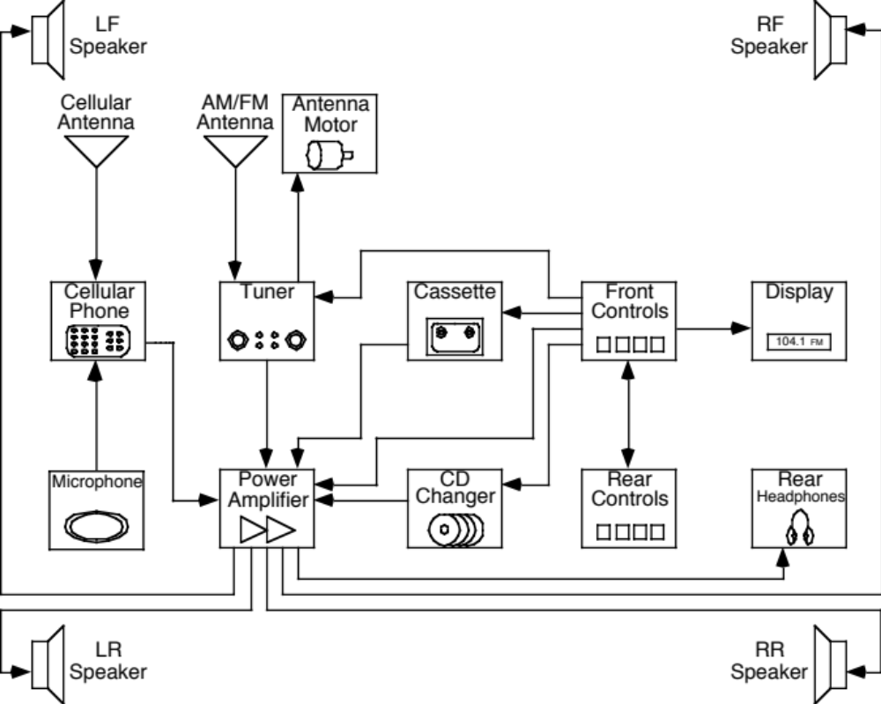
Audio System Exercise:
Where are the Chunks?

Slide 49
Fundamental Decisions
Integral vs. modular architecture?
What type of modularity?
How to assign functions to chunks?
How to assign chunks to teams?
Which chunks to outsource?

Slide 50
Practical Concerns
Planning is essential to achieve the desired variety and product change capability.
Coordination is difficult, particularly across teams, companies, or great distances.
Special attention must be paid to handle complex interactions between chunks (system engineering methods).

Slide 51
Product Architecture: Conclusions
Architecture choices define the sub-systems and modules of the product platform or family.
Architecture determines:
  ease of production variety
  feasibility of customer modification
  system-level production costs
Key Concepts:
  modular vs. integral architecture
  clustering into chunks
  planning product families

Slide 52
Other Images

Slide 53
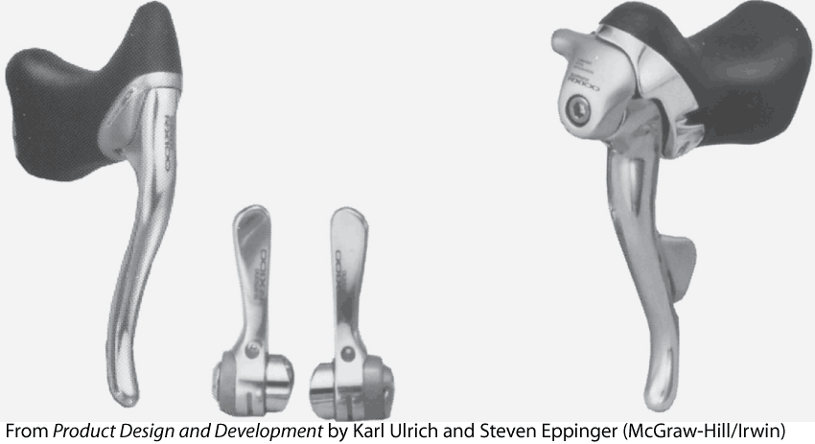

Slide 54
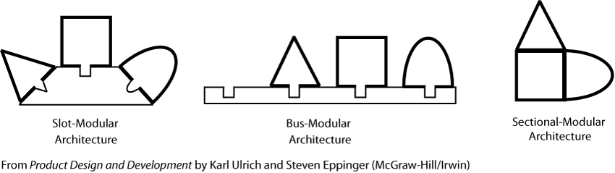

Slide 55
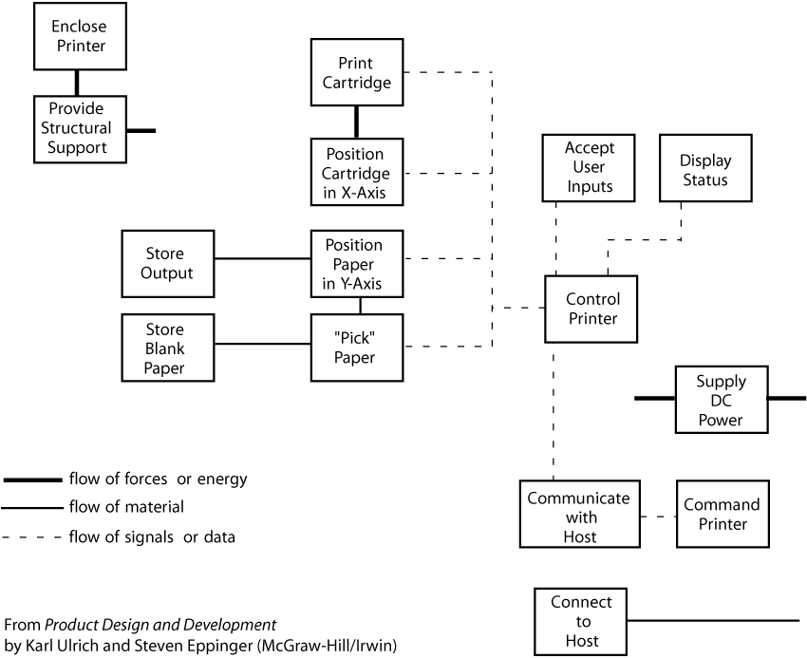

Slide 56
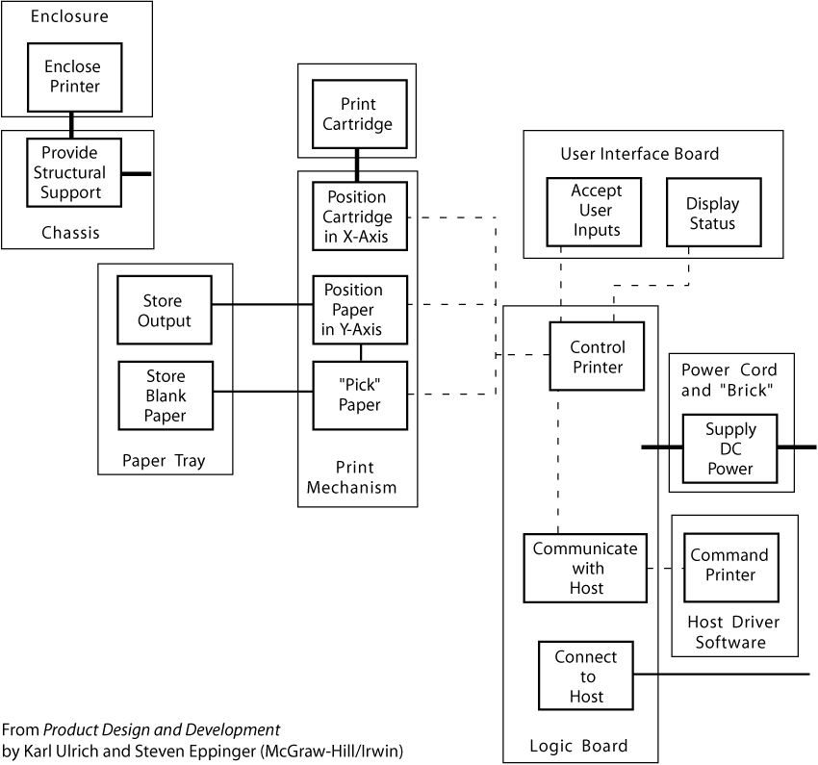

Slide 57
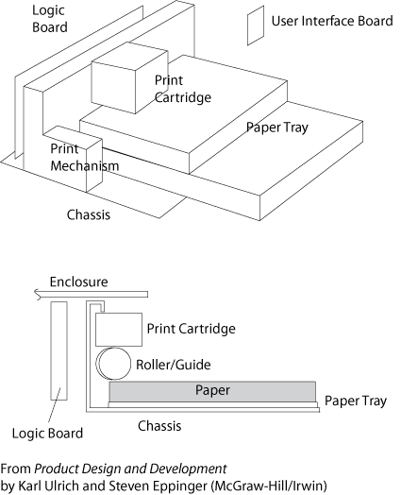

Slide 58
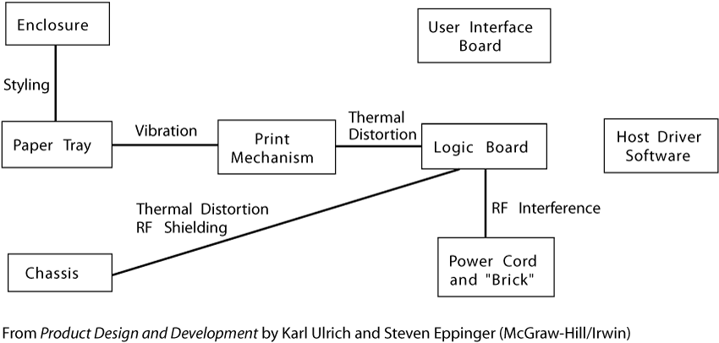

Slide 59
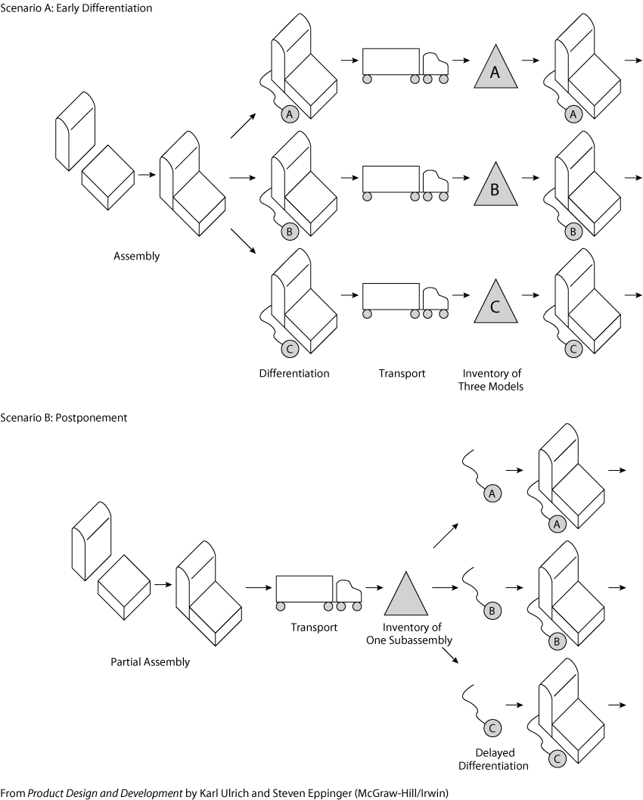

Slide 60
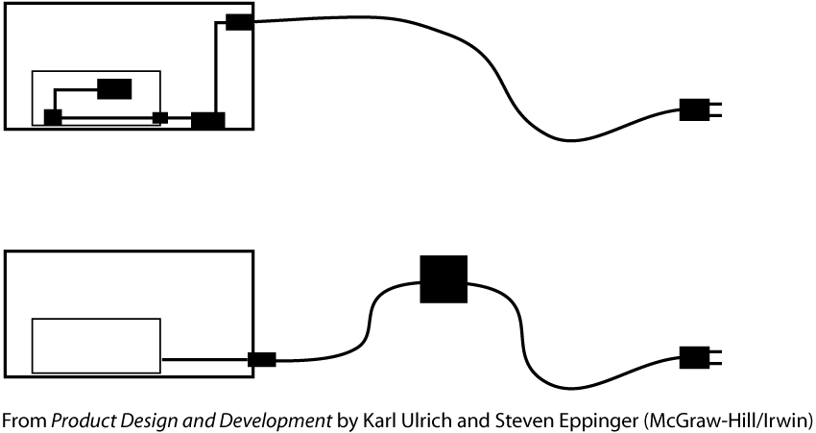

Slide 61


Slide 62
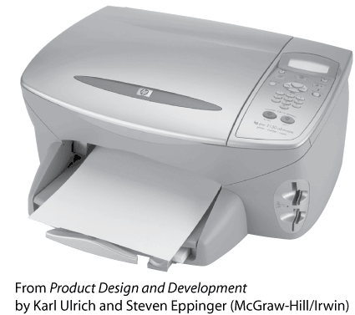

Slide 63
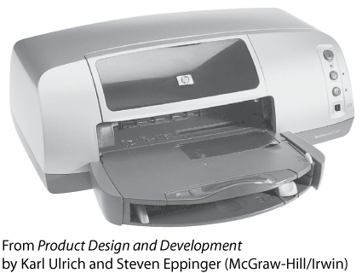

Slide 64
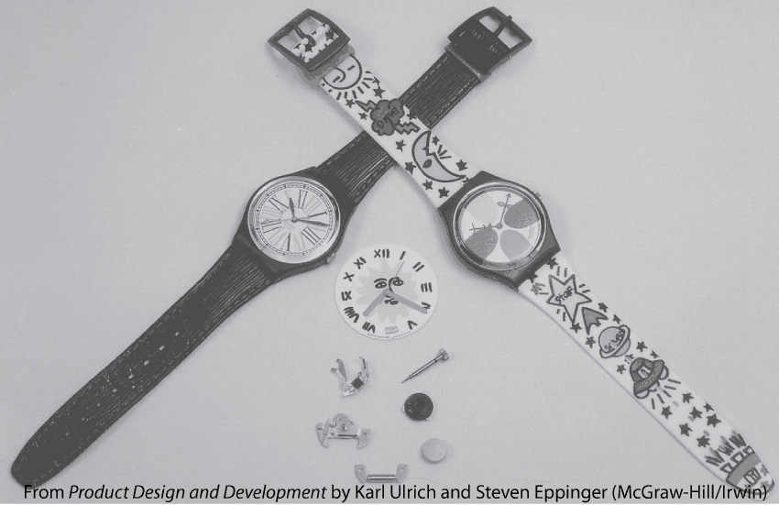

Slide 65
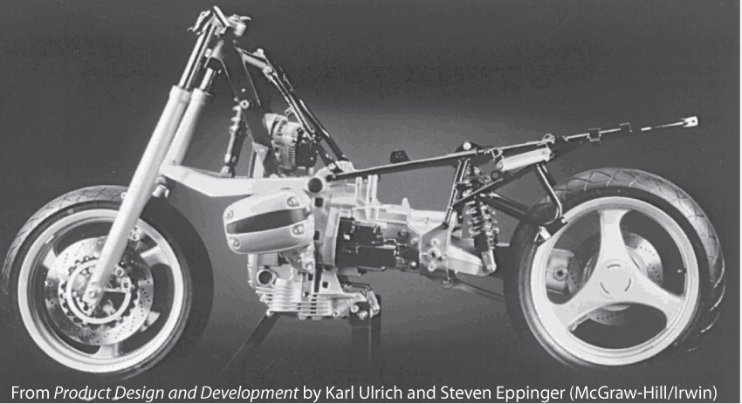

Slide 66


